Slide 1
Key Distribution and Management

Slide 2
Symmetric key distribution using trusted third party
Symmetric key distribution without trusted third party
Kerberos as KDC
Certification Authorities

Slide 3
Symmetric key distribution
N people
N(N-1) -- bidirectional communication
N(N-1)/2 – same key for both directions
N^2 problem

Slide 4
KDC

Slide 5
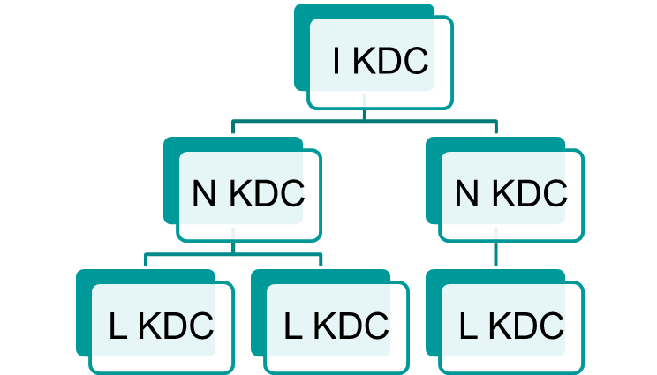
Key Distribution Center
Flat multiple KDCs
Hierarchical multiple KDCs
KDC
KDC
KDC

Slide 6
Protocol using Key Distribution Center (KDC)
Responsible for distributing keys to pairs of users (hosts, processes, applications)
Each user must share a unique key, the master key, with the KDC
  Use the master key to communicate with KDC to get a temporary session key for establishing a secure “session” with another user
  Master keys are distributed in some non-cryptographic ways

Slide 7
A Typical Key Distribution Scenario
KDC
(1) Request(A,B)
(2) E_{Ka}[K_{s}|E_{Kb}(K_{s},ID_{A})]
(3) E_{Kb}[K_{s},ID_{A}]
A
(4) E_{Ks}[N₂]
B
(5) E_{Ks}[f(N₂)]
K_{a}, K_{b} are master keys, K_{s} is a session key

Slide 8
Kerberos
Authentication protocol + KDC
Authentication server and Ticket granting server

Slide 9
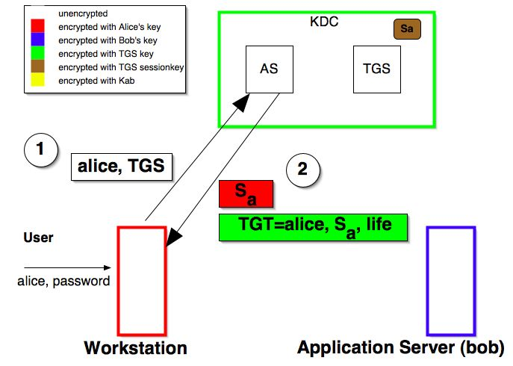

Slide 10
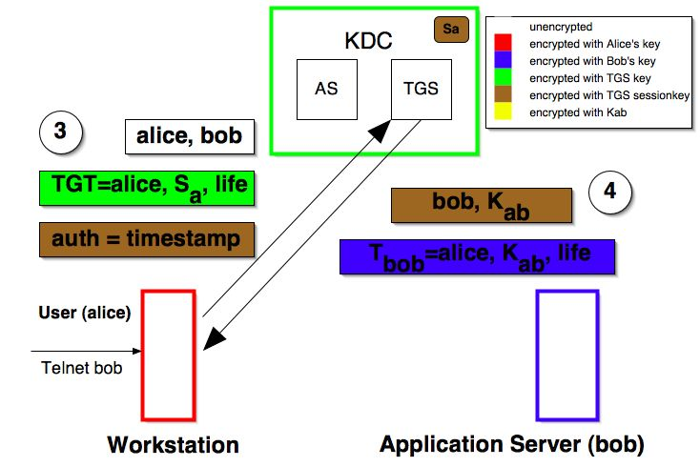

Slide 11
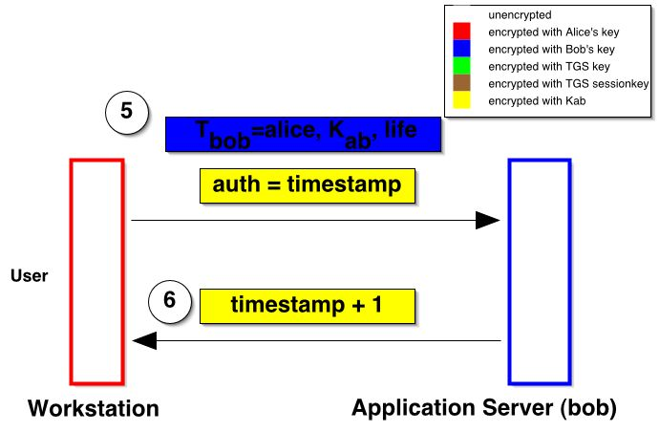

Slide 12
Symmetric key agreement –
Diffie Hellman key agreement

Slide 13
Public key Distribution
Public announcement :
damage could be done
Trusted Center
Controlled Trusted Center
Include public key signed by trusted center and time stamp. B wants A key will send request with timestamp.TC will send PV + TS digitally sign.
more users - more traffic
Certification Authority
B goes to CA proves won identity . CA adds public key and sign that certificate

Slide 14
Digital Certificate
Passport on WEB
Issues in key management or key exchange
Solution Diffie-Hellman
Asymmetric key, issues in distribution of public key

Slide 15
Digital Certificate
A small computer file “mita.cer”
Must be issued by the authority whom every one trusts.
Relation between user and her public key

Slide 16
contain
Subject name : Alice Carriel
Public key :FD 43 .. .. .. ..32
Serial No :123456789
Other :
Valid form :23 April 2005
Valid to :22 April 2006
Issuer name : VeriSign

Slide 17
Certificate authority
Is a trusted agency that can issue digital certificate
ex..Govt. , Post office, financial institution, software company
  VeriSign
  Entrust
India’s first CA – safescrypt lmt

Slide 18
Standard X.509
ITU( International Telecommunication Union) in 1988 (X.500)
Revised in 1993, 1995
Current version X.509V3
rfc2459

Slide 19
Standard X.509
Version :
Certificate serial No
Signature algorithm identifier
Issuer name
Validity
Subject name
Subject public key
Issue unique identifier
Subject Unique identifier
Extensions
CA’s digital signature
V 1
V2
V3

Slide 20
Standard X.509
Extension
  Authority Key Identifier
  Subject Key Identifier
  Key Usage
  Extended key usage
  Private Key Usage Period
  Certificate policies
  Policy mapping
  Subject alternative name
  Issuer alternative name
  Subject directory attribute
  Basic constrain
  Name constrain
  Policy constrain

Slide 21
Registration Authority
Work on behalf of CA
RA is intermediate entity between user and CA
  Accepting and verifying registration info
  Generating key
  Accepting & authorizing request key backups & certificate revocation
RA not issuing any Digital certificate

Slide 22
Registration Authority
User 1
Registration
Authority
Certification
Authority
User 1
User 1

Slide 23
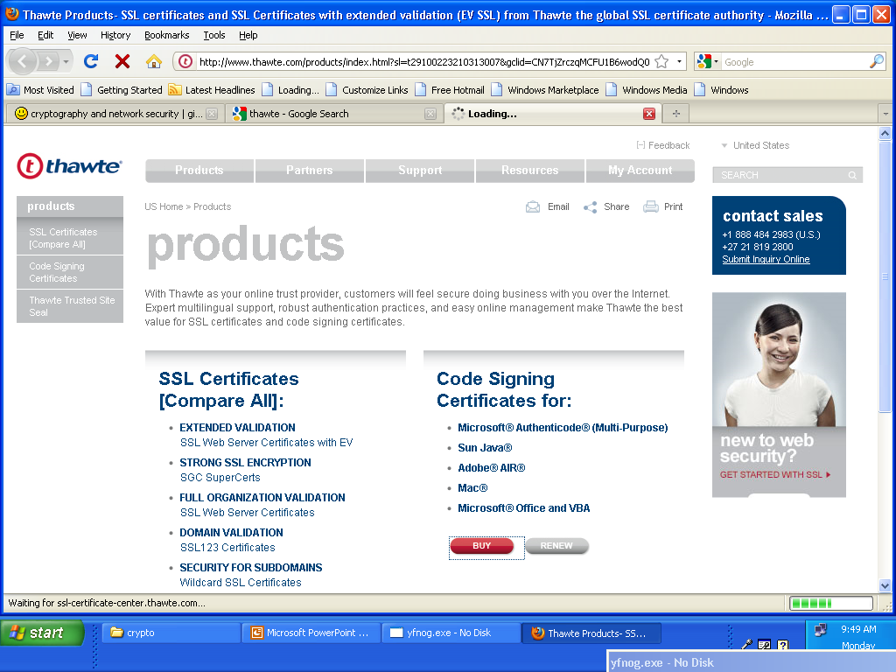

Slide 24
Certificate creation stapes
Step 1 : Key generation
Step 2 : Registration
Step 3 : Verification
Step 4 : Certificate creation

Slide 25
Key generation
Ways
1. User generates key pair and sends only public key along with other information to RA and keeps private key securely with him/her only.
2. RA or CA generate the key pair
  User is not aware of algorithms
  Central key management
  Disadvantages is RA knows users public key

Slide 26
Registration
Certificate Signing Request (CSR) format for registration
PKCS#10

Slide 27
Verification steps
1. User’s credential verification
    Organization – business records, historical doc, creditability proofs
    Individuals – postal address , email-id etc
2. Correctness of public key
  POP “Proof Of Possession” of private key
    User digitally signs the Certificate Signing Request (CSR)
    RA sends random number encrypted with public key
    Dummy certificate encrypted with public key

Slide 28
Certificate creation
After getting all information RA sends all information to CA, CA creates certificate in X.509 format and sends copy to user and keeps one copy along with him

Slide 29
Signing Digital certificate
CA signs this certificate using his private key
      Version :
      Certificate serial No :
      Signature algorithm identifier :
      Issuer name :
      Validity :
      Subject name :
      Subject public key :
      Issue unique identifier :
      Subject Unique identifier :
      Extensions :
      CA’s digital signature
Message Digest
Encrypt with CA
private key

Slide 30
Verification of Digital Certificate
Reads certificate
Finds message digest of the certificate excluding the last signature data
Compares the message digest along with the last data of the certificate
If equal, certificate is verified

Slide 31
PKI
Model for creating , distributing and revoking certificates based on x.509
Duties
  Certificates issuing , renewal and revocation
  Key’s storage and update
  Providing services to other protocols
  Providing access control

Slide 32
Certificate hierarchies
Root CA
Second level CA(A1)
Second level CA (A2)
Second level CA (A3)
Third Level CA (B1)
Third Level CA (B2)
Third Level CA (B3)
Third Level CA (B4)
Alice
Bob
CA<<A1>>

Slide 33
Cross Certification
Root CA
Root CA
Level 1 CA
Level 1 CA
Level 1 CA
Level 1 CA
Level 1 CA
Level 1 CA
Alice
Bob

Slide 34
Certificate revocation
Loss of key
Mistake while issuing certificate
Withdrawal of certificate ( person left organization)
DS Revocation Check
Offline check
Online
CRL
OCSP
SCVP
CRL :Certificate revocation list
OCSP : Online Certification Status Protocol
SCVP : Simple Certificate Verification Protocol

Slide 35
CRL- Certificate Revocation List
CA : VeriSign CRL Date : 1 Jan 2005, 10:00am
Serial No | Date | Reason
1234567 | 30 Dec 2004 | Job Changed
246801 | 25 Dec 2004 | On request
. . . . | . . . . | . . . .

Slide 36
Type of Certificate
Email certificates
  email
Server-side SSL certificates
  merchant
Client-side SSL certificates
  customer
Code-signing certificates
  Java applet, ActiveX,..

Slide 37
Private Key Management
Protecting Private Keys
    Password protection
    PCMCIA cards
    Tokens
    Biometrics
    Smart cards
Multiple key pairs
Key updates

Slide 38
Needham-Schroeder Protocol
original third-party key distribution protocol
for session between A B mediated by KDC
protocol overview is:
  1. A→KDC: ID_{A} || ID_{B} || N₁
  2. KDC→A: E_{Ka}[Ks || ID_{B} || N₁ || E_{Kb}[Ks||ID_{A}] ]
  3. A→B: E_{Kb}[Ks||ID_{A}]
  4. B→A: E_{Ks}[N₂]
  5. A→B: E_{Ks}[f(N₂)]
Notes:
This is the original, basic key exchange protocol. Used by 2 parties who both trusted a common key server, it gives one party the info needed to establish a session key with the other. Note that since the key server chooses the session key, it is capable of reading/forging any messages between A&B, which is why they need to trust it absolutely!
Note that all communications is between A&KDC and A&B, B&KDC don't talk directly (though indirectly a message passes from KDC via A to B, encrypted in B's key so that A is unable to read or alter it). Other variations of key distribution protocols can involve direct communications between B&KDC.

Slide 39
Needham-Schroeder Protocol
used to securely distribute a new session key for communications between A & B
but is vulnerable to a replay attack if an old session key has been compromised
  then message 3 can be resent convincing B that is communicating with A
modifications to address this require:
  timestamps
  using an extra nonce
Notes:
There is a critical flaw in the protocol, as shown. This emphasises the need to be extremely careful in codifying assumptions, and tracking the timeliness of the flow of info in protocols. Designing secure protocols is not easy, and should not be done lightly. Great care and analysis is needed.

Slide 40
Using Public-Key Encryption
have a range of approaches based on the use of public-key encryption
need to ensure have correct public keys for other parties
using a central Authentication Server (AS)
various protocols exist using timestamps or nonces

Slide 41
Java command keytool

Slide 42
keytool - Key and Certificate Management Tool
Manages a keystore (database) of private keys and their associated X.509 certificate chains authenticating the corresponding public keys. Also manages certificates from trusted entities.
keytool is a key and certificate management utility. It enables users to administer their own public/private key pairs and associated certificates for use in self-authentication (where the user authenticates himself/herself to other users/services) or data integrity and authentication services, using digital signatures. It also allows users to cache the public keys (in the form of certificates) of their communicating peers.

Slide 43
Adding Data to the Keystore

Slide 44
-genkey {-alias alias} {-keyalg keyalg} {-keysize keysize} {-sigalg sigalg} [-dname dname] [-keypass keypass] {-validity valDays} {-storetype storetype} {-keystore keystore} [-storepass storepass] [-provider provider_class_name] {-v} {-Jjavaoption} Generates a key pair (a public key and associated private key). Wraps the public key into an X.509 v1 self-signed certificate, which is stored as a single-element certificate chain. This certificate chain and the private key are stored in a new keystore entry identified by alias.
keyalg specifies the algorithm to be used to generate the key pair, and keysize specifies the size of each key to be generated. sigalg specifies the algorithm that should be used to sign the self-signed certificate; this algorithm must be compatible with keyalg.
dname specifies the X.500 Distinguished Name to be associated with alias, and is used as the issuer and subject fields in the self-signed certificate. If no distinguished name is provided at the command line, the user will be prompted for one.
keypass is a password used to protect the private key of the generated key pair. If no password is provided, the user is prompted for it. If you press RETURN at the prompt, the key password is set to the same password as that used for the keystore. keypass must be at least 6 characters long. Be careful with passwords valDays tells the number of days for which the certificate should be considered valid.

Slide 45
-import {-alias alias} {-file cert_file} [-keypass keypass] {-noprompt} {-trustcacerts} {-storetype storetype} {-keystore keystore} [-storepass storepass] [-provider provider_class_name] {-v} {-Jjavaoption} Reads the certificate or certificate chain (where the latter is supplied in a PKCS#7 formatted reply) from the file cert_file, and stores it in the keystore entry identified by alias. If no file is given, the certificate or PKCS#7 reply is read from stdin.
keytool can import X.509 v1, v2, and v3 certificates, and PKCS#7 formatted certificate chains consisting of certificates of that type. The data to be imported must be provided either in binary encoding format, or in printable encoding format (also known as Base64 encoding) as defined by the Internet RFC 1421 standard. In the latter case, the encoding must be bounded at the beginning by a string that starts with "-----BEGIN", and bounded at the end by a string that starts with "-----END".
You import a certificate for two reasons:
to add it to the list of trusted certificates, or
to import a certificate reply received from a CA as the result of submitting a Certificate Signing Request

Slide 46
C:\Program Files\Java\jre6\bin>keytool -genkeypair -alias my_certificate -keystore my_keystore.pfx -storepass my_password -validity 365 -keyalg RSA -keysize 2048 -storetype pkcs12
What is your first and last name?
[Unknown]: admin
What is the name of your organizational unit?
[Unknown]: vesit
What is the name of your organization?
[Unknown]: ves
What is the name of your City or Locality?
[Unknown]: mumbai
What is the name of your State or Province?
[Unknown]: maharashtra
What is the two-letter country code for this unit?
[Unknown]: IN
Is CN=admin, OU=vesit, O=ves, L=mumbai, ST=maharashtra, C=IN correct?
[no]: y

Slide 47
C:\Program Files\Java\jre6\bin>keytool -v -list
Enter keystore password:
Keystore type: JKS
Keystore provider: SUN
Your keystore contains 1 entry
Alias name: test
Creation date: Aug 13, 2012
Entry type: PrivateKeyEntry
Certificate chain length: 1
Certificate[1]:
Owner: CN=xcvv, OU=xccv, O=xcv, L=xcv, ST=xc, C=xcv
Issuer: CN=xcvv, OU=xccv, O=xcv, L=xcv, ST=xc, C=xcv
Serial number: 502891d1
Valid from: Mon Aug 13 11:04:09 GMT+05:30 2012 until: Sun Nov 11 11:04:09 GMT+05
:30 2012
Certificate fingerprints:
MD5: CD:90:B3:D2:82:A2:D1:1B:CD:85:6D:D5:CA:12:DB:C5
SHA1: E3:18:E4:A3:E9:48:4F:D4:4B:6F:AB:C1:C7:FD:CC:65:3D:35:D3:D2
Signature algorithm name: SHA1withDSA
Version: 3

Slide 48
Browser -> tool -> internet options

Slide 49
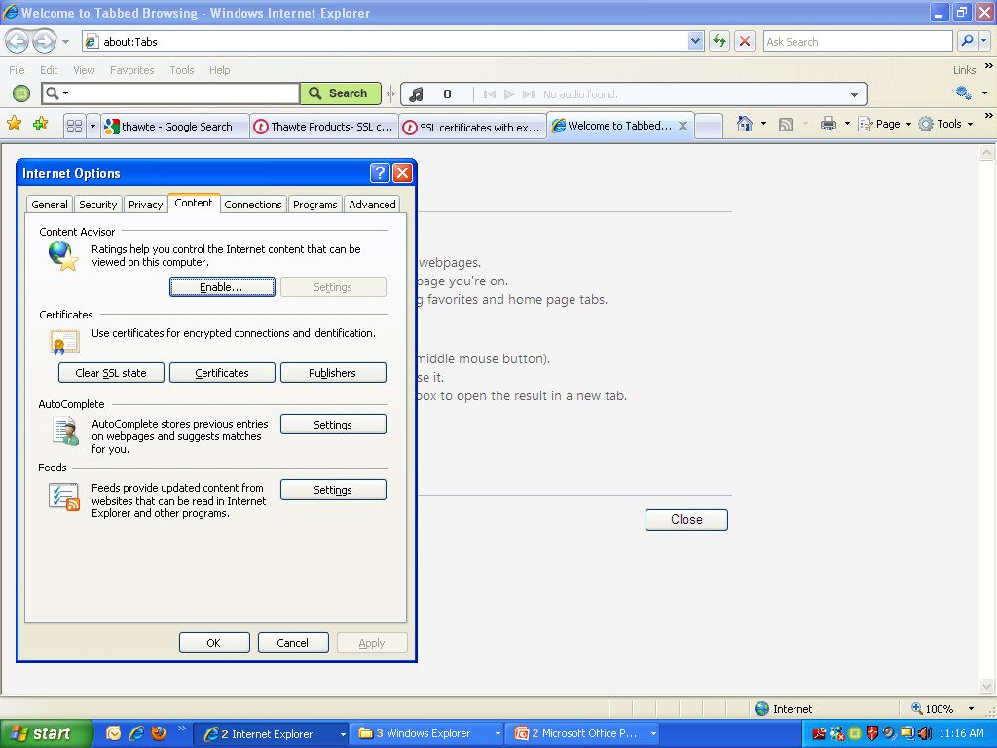

Slide 50
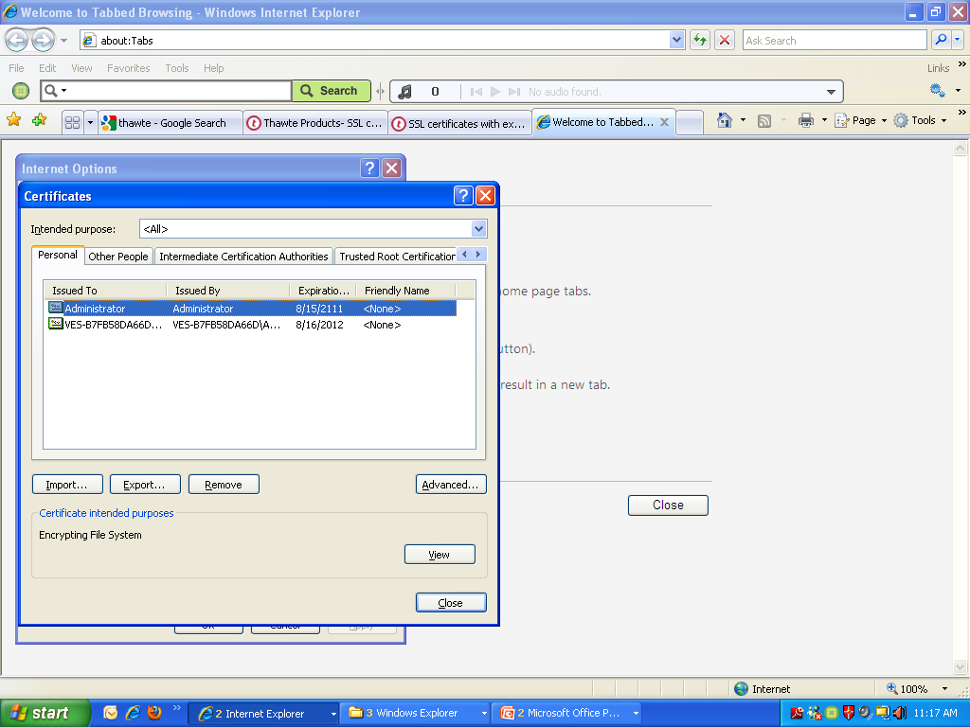

Slide 51
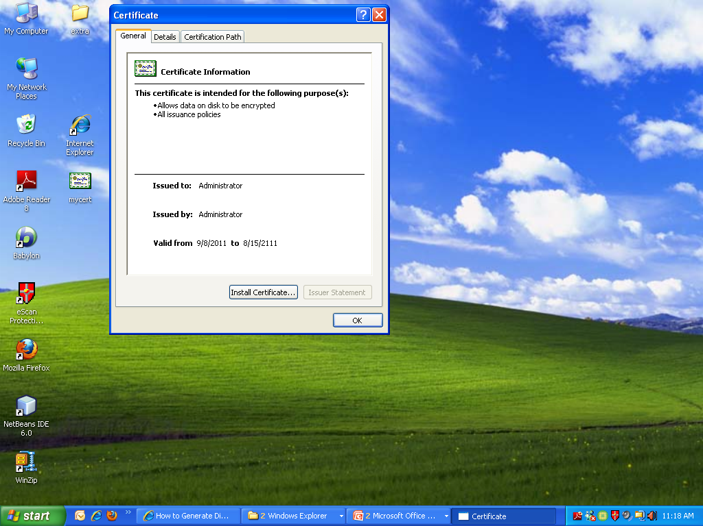

Slide 52
